Slide 1


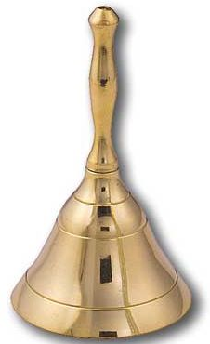

Dingbats ……. say what you see!
Speeding up

Slide 2
Velocity, Speed and Acceleration
LOs:
- Explain the difference between speed and velocity
- Be able to use the acceleration formula

Slide 3
Speed vs. Velocity
Speed is simply how fast you are travelling…
This car is travelling at a speed of 20m/s
Velocity is “speed in a given direction”…
This car is travelling at a velocity of 20m/s east

Slide 4
Acceleration
Acceleration = change in velocity (m/s)
(m/s²) time taken (s)
A cyclist accelerates from 0 to 10m/s in 5 seconds. What is her acceleration?
A ball is dropped and accelerates downwards at a rate of 10m/s² for 12 seconds. How much will the ball’s velocity increase by?
A car accelerates from 10 to 20m/s with an acceleration of 2m/s². How long did this take?
A rocket accelerates from 1,000m/s to 5,000m/s in 2 seconds. What is its acceleration?

